Slide 1
Vacation Neighborhood Selection
Anna Keshabyan
March 30, 2019

Slide 2
Background
While travelling has become much easier and more affordable over the past decade, planning a vacation can still be hard
For those who are planning vacation on their own, selecting the right neighborhood to stay at during vacation can be extremely important
For this project, I developed a tool that can help travelers save some time when looking for the best neighborhood to stay in during their vacation

Slide 3
Project Scope
To simplify the task, I used data about neighborhoods in 3 Californian cities: San Francisco, Los Angeles and San Diego

Slide 4
Data Acquisition & Cleaning
The data about neighborhoods was scraped from Wikipedia pages using BeautifulSoup and geocoded
I further used FourSquare API to get information on types of venues available in each neighborhood
To avoid overfitting, I reduced the number of possible venue categories from 391 to 6: accommodation, food, nature, culture, entertainment, & transit

Slide 5
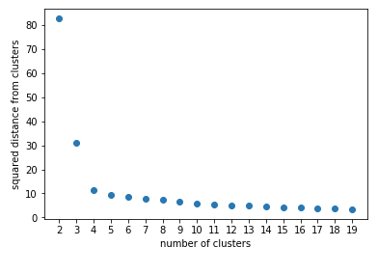
K-Means Clustering
I ran K-Means clustering to identify the groups of neighborhoods in 3 cities that are similar to each other
First, I created a scree plot to find out how many cluster would be optimal to have and found out that the optimal number of clusters is 4

Slide 6
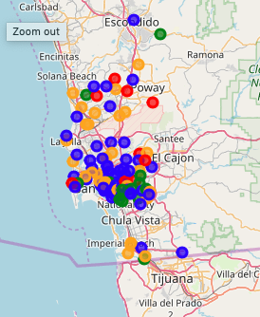
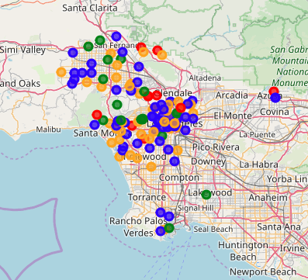
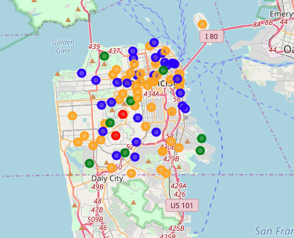
The Cluster Map
San Diego
Los Angeles
San Francisco
The resulting clusters were mapped using follium

Slide 7
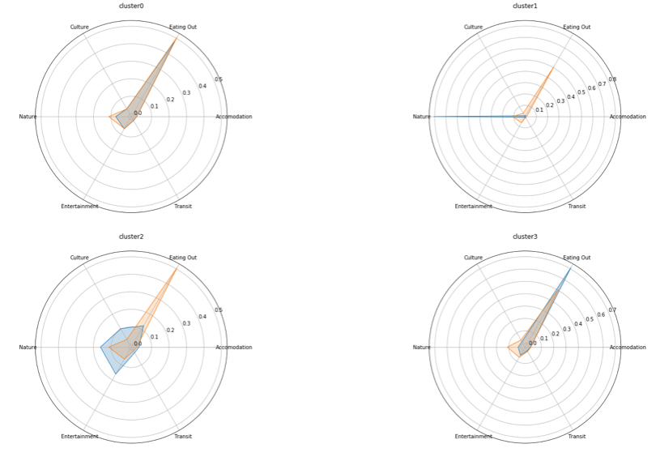
Cluster Descriptions
I also examined how clusters differ from the mean on their key characteristics using radar plots
The radar plots demonstrate the Cluster 0 and Cluster 3 contain most of the city neighborhoods with numerous food and entertainment venues
Cluster 1 unites neighborhoods with plenty of natural sights like parks, beaches, and trails
Cluster 2 has neighborhood with vibrant cultural and entertainment scene

Slide 8
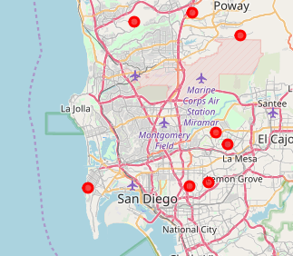
Use Case #1
For Use Case #1, I used outcomes of the clustering model to recommend neighborhoods
Scenario: Pam lives in Los Angeles in Hollywood Hills neighborhood. Pam loves just about everything about where she lives. In a month, she is going for a vacation in San Diego. She definitely wants to explore the city, but she also wants for the neighborhood she stays at to be as similar to Hollywood Hills as possible. She wants to know which neighborhoods she should consider staying at. She also wants to know about the popular spots in that area
I was able to identify 9 neighborhoods in San Diego area that are similar to Hollywood Hills

Slide 9
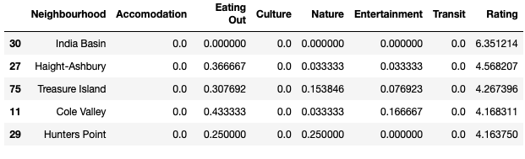
Use Case #2
For use case #2, I used a linear regression model that predicted the neighborhoods a person might like based on the neighborhoods they’ve already been to and ranked
Scenario: Jim lives in Los Angeles and has to go to San Francisco for a business meeting. Jim has rated several neighborhoods in Los Angeles on a 1-5 scale where 5 is the highest ranking and 1 is the lowest. Jim has also went to San Diego for vacation last year and ranked some neighborhoods there as well. Jim wants to know the names of neighborhoods in San Francisco that would be the best for him to visit or stay at.
The model was able to come up with the names of neighborhoods Jim is most likely to enjoy based on his ratings of 15 neighborhoods in Los Angeles and San Diego

Slide 10
Conclusions and Next Step
K-Means clustering was able to identify 4 unique groups of California neighborhoods
The results of the clustering were successfully used to develop a recommendation tool
Integrating linear regression into the recommendation tool allows to take into the account the rankings of the neighborhoods entered by the user
Next step would be developing a collaborative filtering model that would take in the rankings from multiple users and use those ranking to make more accurate recommendations

